Slide 1
2023 DL Final project
100 Sports Image Classification Competition

Slide 2
Dataset: 100 Sports Image Classification
Deadline: 2024/1/5 23:59 (We do not accept any late submission)
Sunmission format:
Team’s name: <team_ID>
Submission file: <team_1_submission.csv>
Submission file on E3:<team_ID.zip>
Grading :
We will rank the projects from the leaderboard.
The maximum point will be 100, second will be 97, and so on.
The last group will get 55 points.

Slide 3
Kaggle Competition
Kaggle is an online community of data scientists and machine learning practitioners.
Kaggle allows users to find and publish datasets, exploring and building models in a web-based data-science environment.
Participants experiment with different techniques and compete against each other to produce the best models.
For most competitions, submissions are scored immediately and summarized on a live leaderboard.

Slide 4
Dataset
100 Sports Image has 100 classes containing at least 90 images each.
Images are 224,224,3 jpg format.
Data is separated into train, test and valid directories.

Slide 5

Kaggle Competition Link
Here is the link to the introduction and data format instructions.
https://www.kaggle.com/t/7a109bf7ac8346b2999ff1ebc6dc931a

Slide 6
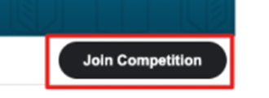
How to use Kaggle?
Go to link for Kaggle competition, then click “join competition” (you need to have Kaggle account)
Please assign one person as the team leader to invite the other members to join the group.
The number of uploads is limited per day, please double-checked with your members before uploading the file.
Named your team’s name in the format of <team_ID>.

Slide 7
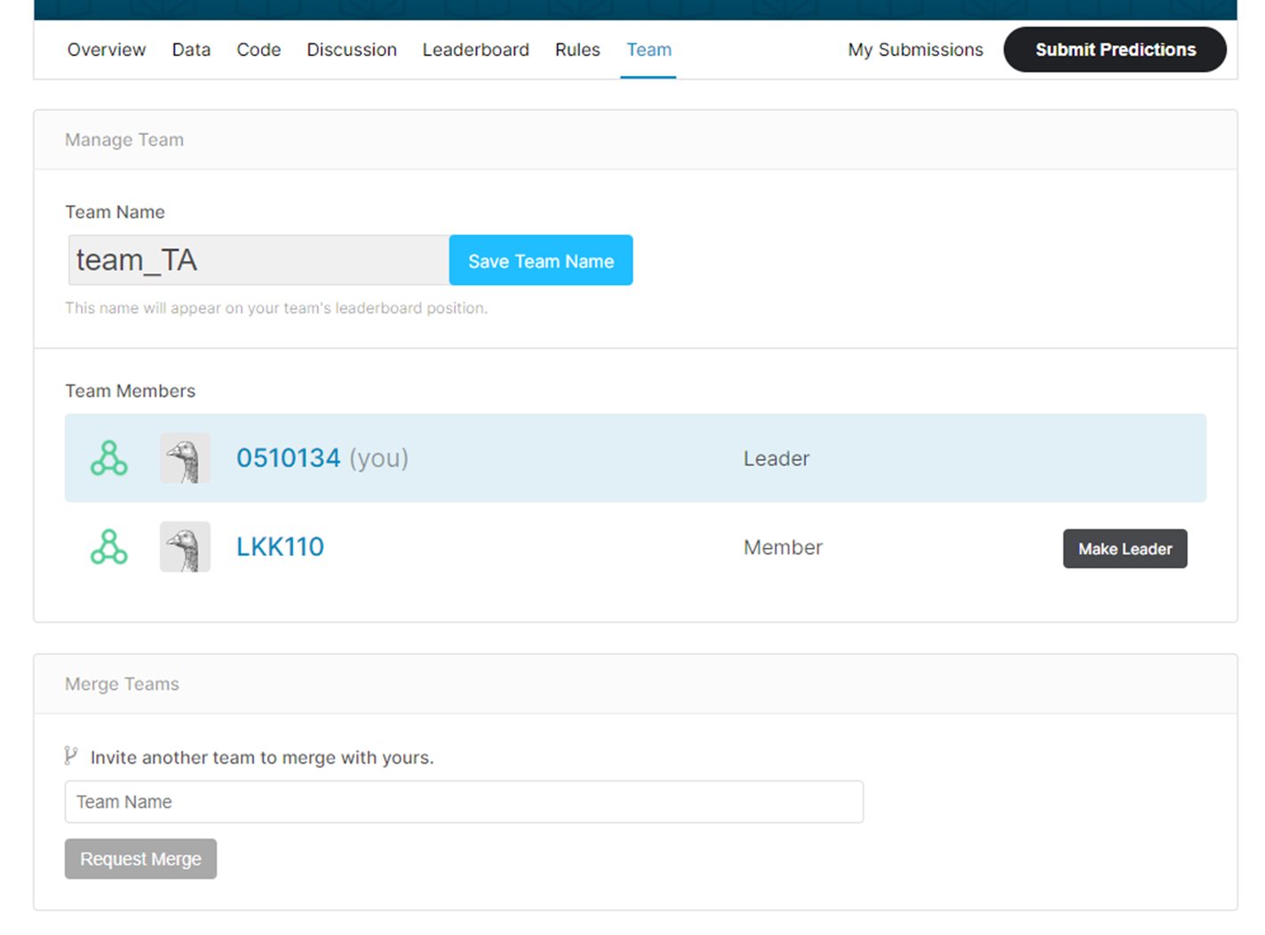





Slide 8
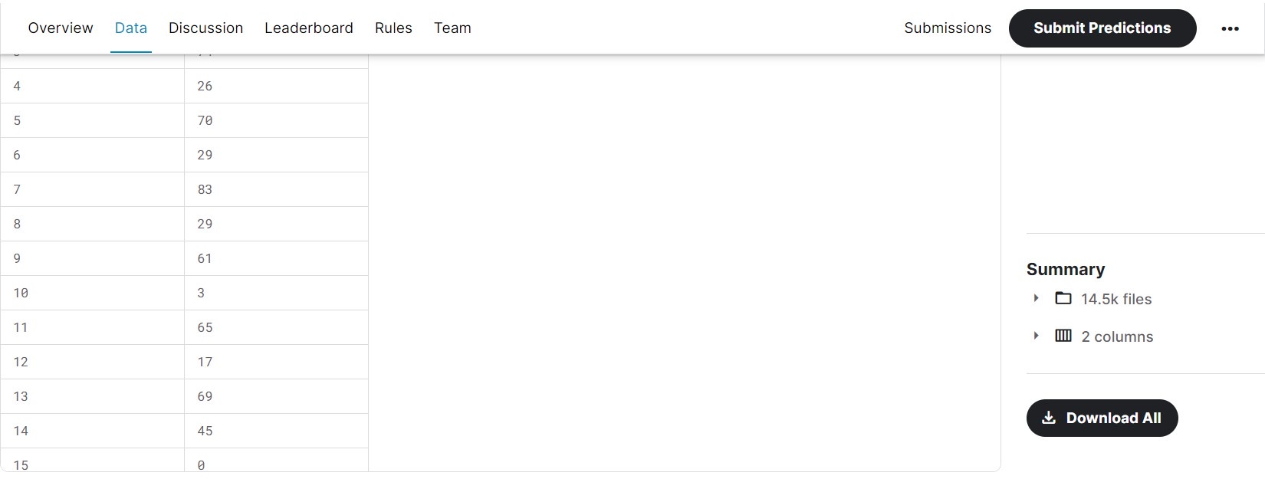
How to load the data
You can download the data in our Kaggle competition:
There may be some similar dataset in other Kaggle competition, but we made some adjustments to the test directories, so please download the data directly from our Kaggle competition.

Slide 9

Submit Prediction
Use the training data to train model, and predict the test data. You should upload to Kaggle in <team_ID_submission.csv> format.
Leaderboard will evaluate the result on every new submission.
Each group can only upload 20 times each day.

Slide 10
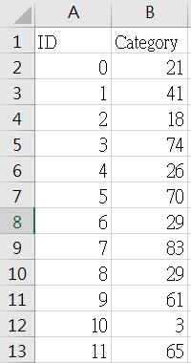
Submission Format
Submission files should name as (e.g., team_1_submission.csv), it contains two columns: ID and Category (0,1,2,3,…..,99)
Hint: ID and C should be letter.
The file should contain a header and have the
same format as sample_submission.csv.

Slide 11
Submission on E3
Please upload your code on E3 with <team_ID.zip> by one of your teammates before the deadline, or you will be regarded as the last one and receive a score of 55.
In summary, to complete this project, you need to upload a CSV file on Kaggle and also submit the code on E3.

Slide 12
Project restrictions
You can use any package and refer to model frame-work of others. However, copying the result of other groups’ prediction is not allowed in this project.
Each group can only upload 20 times each day.
TA will only provide necessary help.
Please make sure to upload the submission to the leaderboard at least one time before deadline.
Not allow to use test data as train data, or you won’t get any points.

